Slide 1


Summer Training Presentation on
C and C++ by Board Infinity
By-
Sudhanshu Ranjan
12008298

Slide 2
Student Details :-
Name : Sudhanshu Ranjan
Reg number : 12008298
Section : K20GR
Subject : C and C++ Programming
Organization : Board Infinity
Course : Computer Science and Engineering
Course code : CSE343

Slide 3
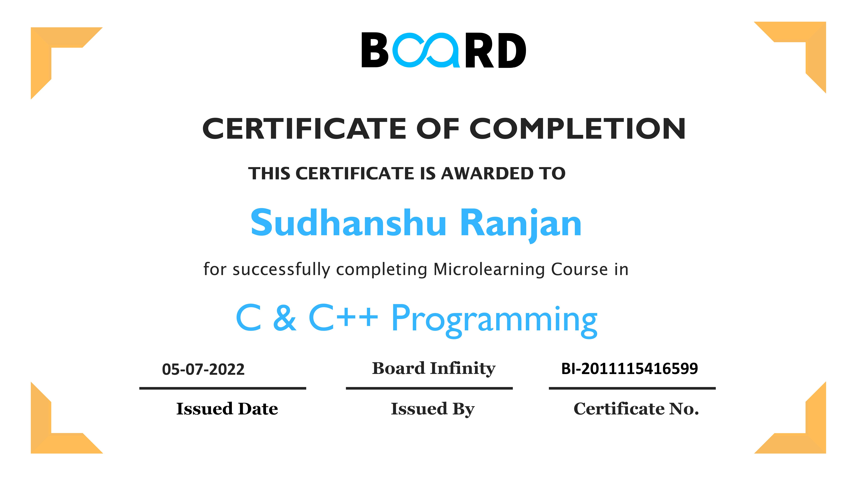

Slide 4
Contents :-
Introduction
Why I chose C and C++ Programming ?
Concepts Learned
Which project did I chose and why?
Contact Management System
Concepts used to Contact Management System
Conclusion
Bibliography

Slide 5
Introduction
C & C++ Programming course is a complete package that helped me to learn Programming language from Basic to an Advance level.
The course offers a wealth of programming challenges that helped me to learn all about Coding and making of an algorithm and how to solve problems and the logic behind the Problem.
One of the benefits of this course is all content will be available once one gets enrolled. One can finish it at his own decided speed. There were video lectures to learn form and coding related questions to practice. I learned Coding techniques for solving various problems with full flexibility of time as I was not time bounded.
This course offers me a wealth of programming challenges that will help me to prepare for interviews with top-notch companies like Microsoft, Amazon, Adobe etc.

Slide 6
Why I choose C and C++ Programming ?
I was interested in Coding and making Projects since my beginning of Semester.
With advancement and innovation in technology, programming is becoming a highly in-demand skill for Software Developers and C++ Language is the identity of a good coder.
C and C++ are often considered to be the root of the Programming of computer science.
It contained a lot of knowledge for such a reasonable price.
This was a lifetime accessible course which I can use to learn even after my training whenever I want to revise.

Slide 7
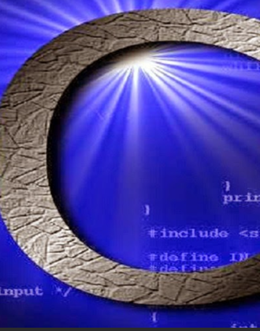
Concepts Learned
C and C++ programming had 15 Topic which was further divided into subtopic and then lectures and tutorials so during my whole 5 week course I learned. Some of important learnings are-
C# BASICS
Importance of C language
Character Sets
Tokens
BASIC DATA TYPES

Slide 8
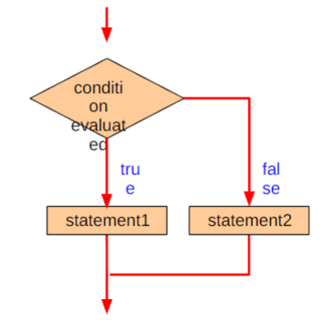
Character(char)
Integer(int)
Floating point (float)
Double floating point(double)
No value available(void)
HEADER FILES
OPERATORS
Debugging in C program
Control Statements in C
The if statement
The IF-ELSE statement
The Switching Statements
The do-while Statement
The while statement
FOR Statements
Array in C
Pointers in C
Structures and Unions

Slide 9
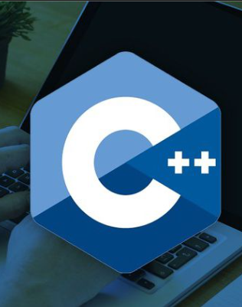
C++ Basics
C++ Characteristics
Abstract Data Types
Function
Standard Template Library
Iostream Library Header files
<iostream.h>
<iomanip.h>
<fstream.h>
Operator Overloading
Initialization and Assignment
Storage Management

Slide 10
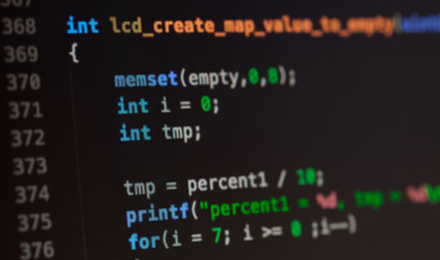
Inheritance & Polymorphism
Single Inheritance
Multiple Inheritance
Hierarchical Inheritance
Multilevel Inheritance
Hybrid Inheritance
Constructor and Destructor Calls
Input and Output in C++ Programs
Exception Handling
Advance in C++ Programming

Slide 11
Which project did I choose and why?
I have choosen Contact management system as my mini project.
Contact management as the name implies is a system that enables you to upkeep the personal contact numbers of the person.
Benefits of Contact Management System-
Enhances customer relationships
Provides better customer insight
Boosts data organization & productivity
Enhances customer satisfaction
Improves internal collaboration

Slide 12
Contact management system
Project in Contact Management System is a simple console application without graphics. It is similar to the contact manager in cell phones. In this project, We can add, view, edit, search and delete contacts. All added and edited records are saved in a file.
We can list contacts by name, phone no., address and email. Overall, understanding the simple source code of this project will teach you how to add, edit, search, list and remove data using a file.
Contact management involves recording and tracking clients and their contact details. This includes:
smartphone numbers
office numbers
emails
social media information

Slide 13
Concepts used to make Contact Management System
File handling
File handling has been used to record all the data in contact management systems.
The other main things which used are data structure, functions, and pointers.
File Handling is the storing of data in a file using a program. In C programming language, the programs store results, and other data of the program to a file using file handling in C. Also, we can extract/fetch data from a file to work with it in the program.
The operations that we can perform on a File using file handing are-
Creating a new file

Slide 14
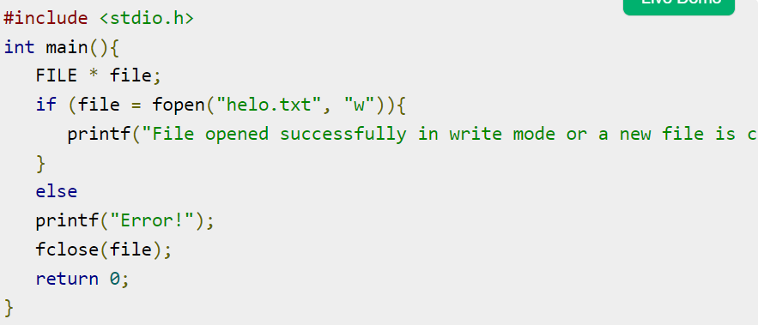
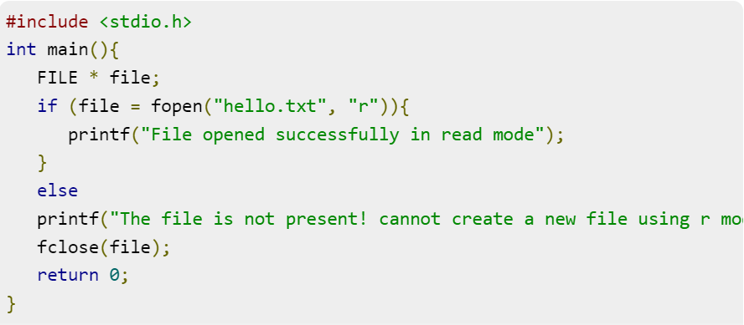
Opening an existing file
Reading data from an existing file
Writing data to a file
Moving data to a specific location on the file
Closing the file

Slide 15
About the Assignment
Generally, the file is used to store the data. The term File Handling refers to the various operations like creating the file, reading from the file, writing to the file, appending the file, etc.
There are two basic operation which is mostly used in file handling is reading and writing of the file. The file becomes stream when we open the file for writing and reading. A stream is a sequence of bytes which is used for communication.
Two stream can be formed from file one is input stream which is used to read the file and another is output stream is used to write in the file.
The key features of contact management system are listed below:
We can add new contacts with information such as name, phone number, address, and email .

Slide 16
About the Assignment
List all contacts:-
lists all the contacts stored in file with their respective contact details.
Search contacts:-
based on name and phone number.
Edit contacts:-
edit information given while adding the contacts – name, phone number, address, and email.
Delete contacts:-
deletes contacts from file.

Slide 17
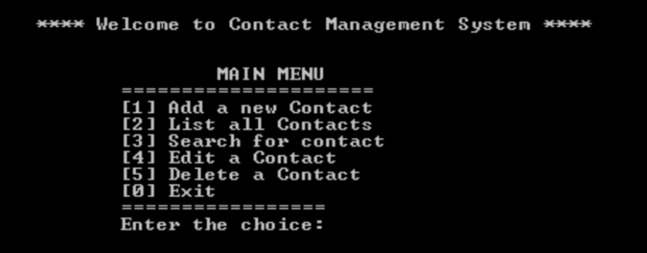
Output :-
After applying the whole code in compilers the output looks like –

Slide 18
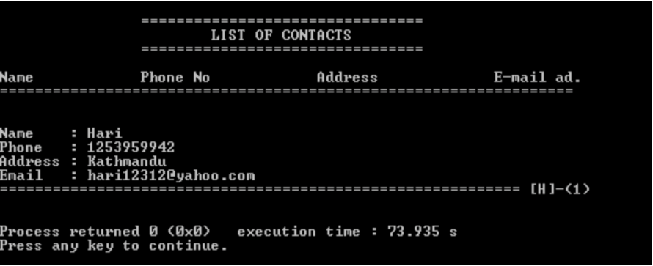

Slide 19
Conclusion
I Learned C & C++ Programming from basic to advanced level.
Learned Topic-wise implementation of C and C++.
Improved my problem-solving skills to become a stronger coder and developer.
Developed my analytical skills on programming and use them efficiently.
Solved problems asked in product-based and service-based companies’ interviews.
Solved problems in contests similar to coding round for SDE role.

Slide 20
BIBLIOGRAPHY
Google
Programming Books
GeeksForGeeks Notes
Wikipedia
Board Infinity official website
C & C++ programming course

Slide 21


